Slide 1
Case Study UI- ElectricityBoardPortal
Submitted By - Hemant Multani

Slide 2
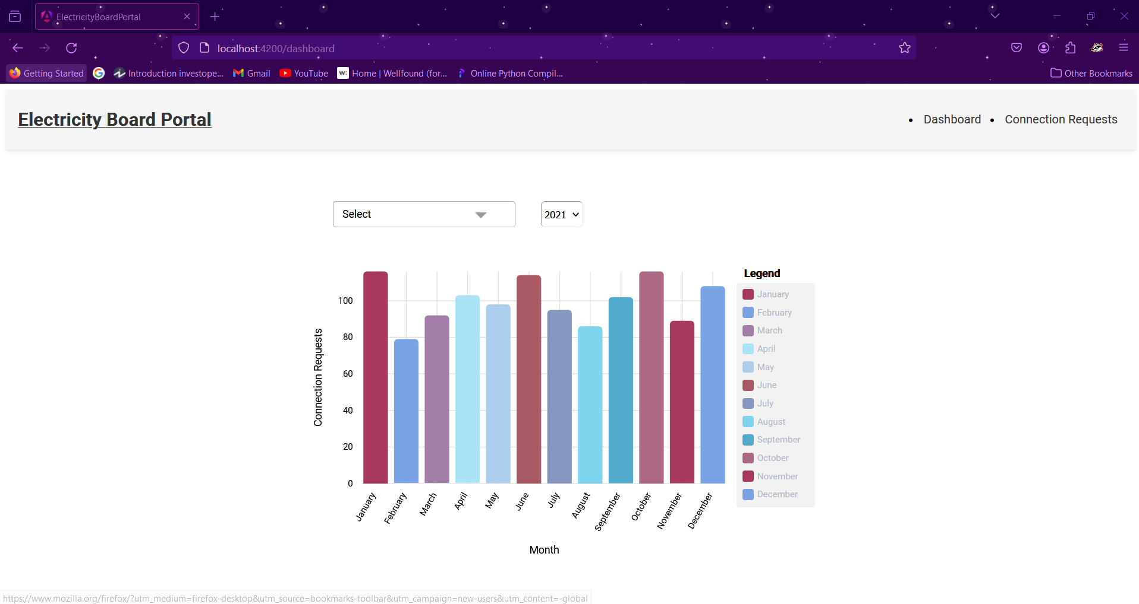
Dashboard Page
Here you will be looking at the visual representation of connection requested by the users for the recent year.
Here from the multiselect option you can select filter the records based on the status and from the dropdown option you can select the year for which you want to visualize the data.

Slide 3
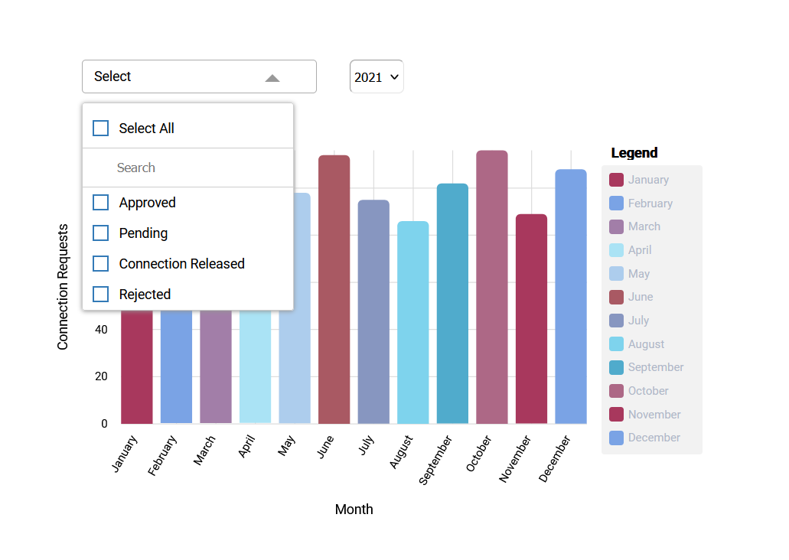
Dashboard Page

Slide 4
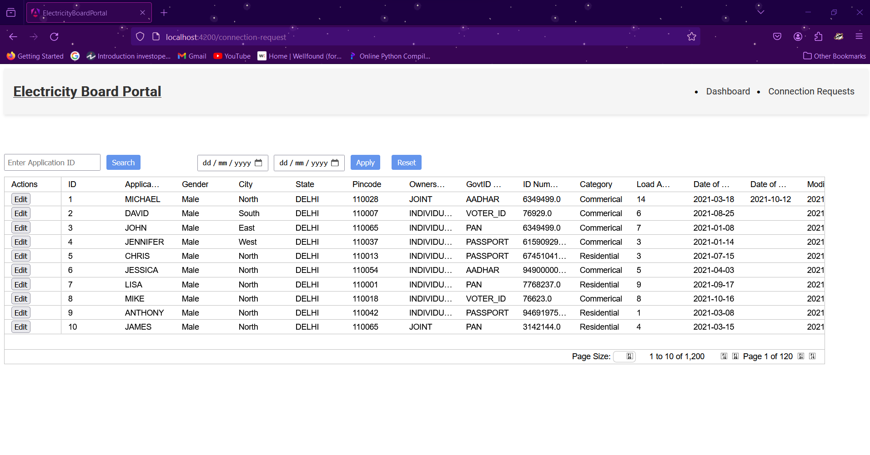
Connection Requests Page
On the Navigation Bar upon clicking the Connection Requests Button you'll be redirected to the Connection Requests Page.
Here you will be able to see first 10 records of the requests mage by the user. For getting the other requests you can use the Implemented Pagination.

Slide 5
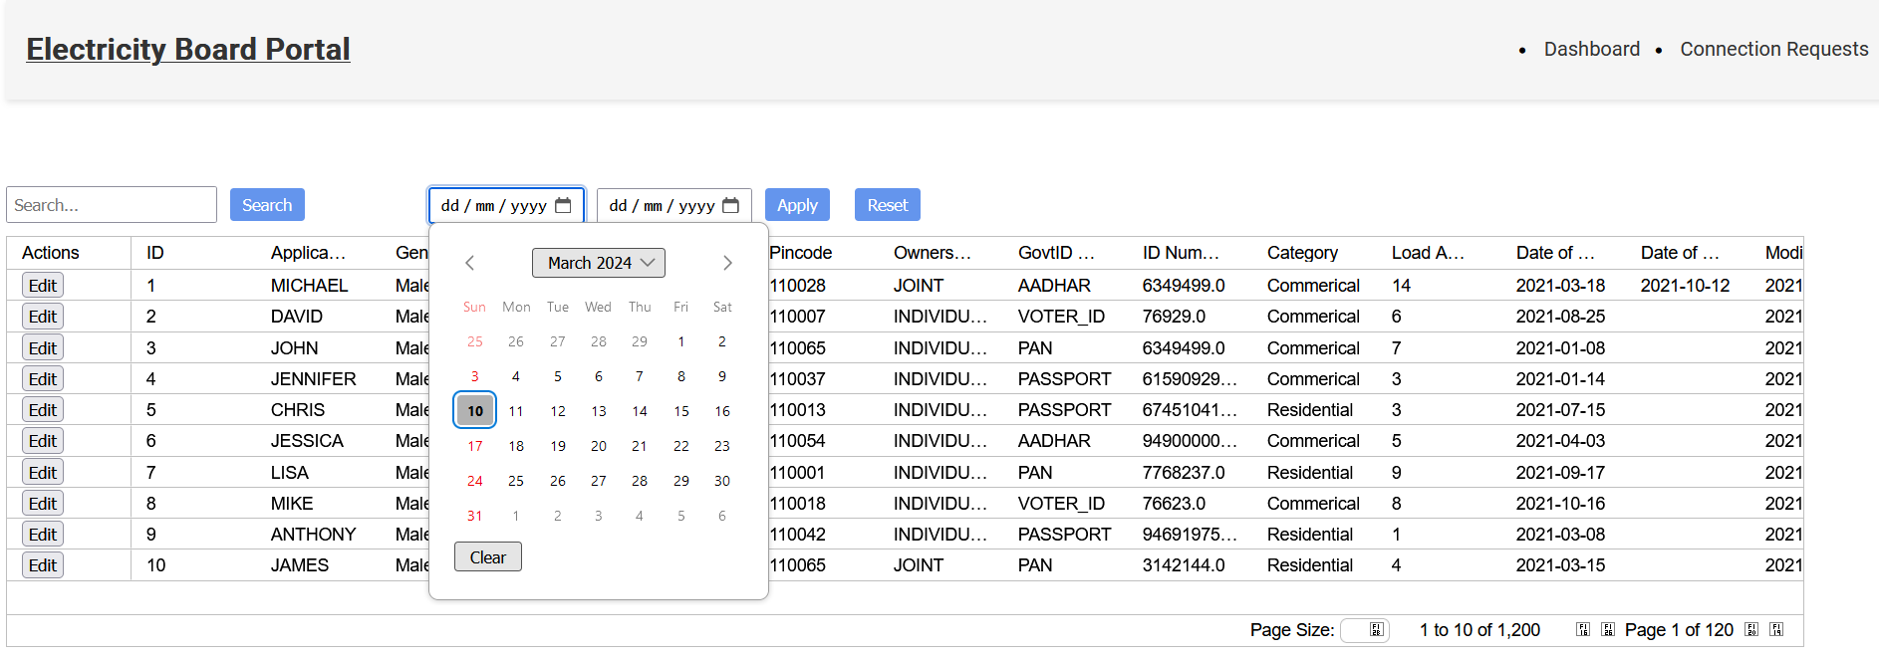
Connection Requests Page
Search Filter - You can write any applicant ID and hit the search button, it will provide you the exact record matching that ID.
Date filter - Select the from and to dates and hit the apply button, you will be provided with the records that have date of application within these dates.

Slide 6
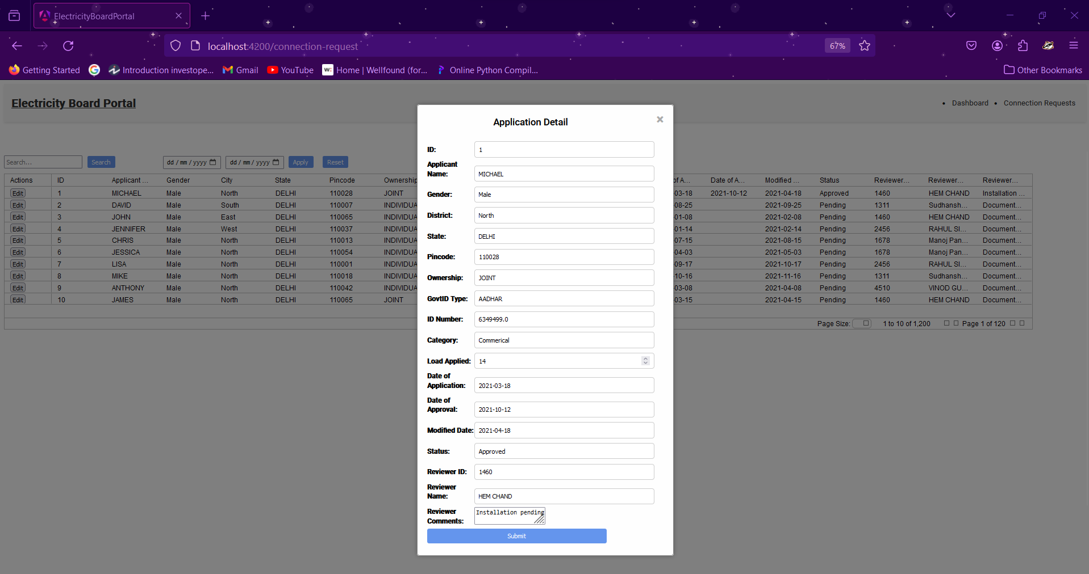
Edit requests Popup
To Edit a connection request click on the edit button on the leftside of the specific record.
Here you can edit the fields of the connection request. (Not all fields can be edited like Date of Application, Govt ID Type, ID Number).
You can now save the records by clicking Submit Button and the record deatils will be updated, which can be viewed at the connection requests Page.

Slide 7
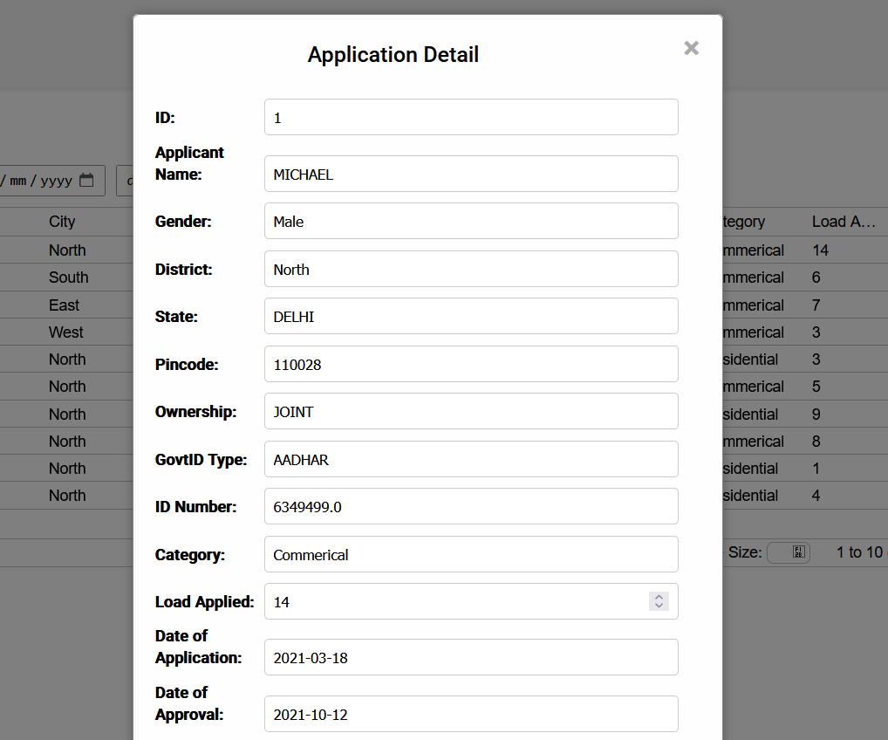
Edit requests Popup

